Slide 1
Mackay note
yurui
20150518

Slide 2
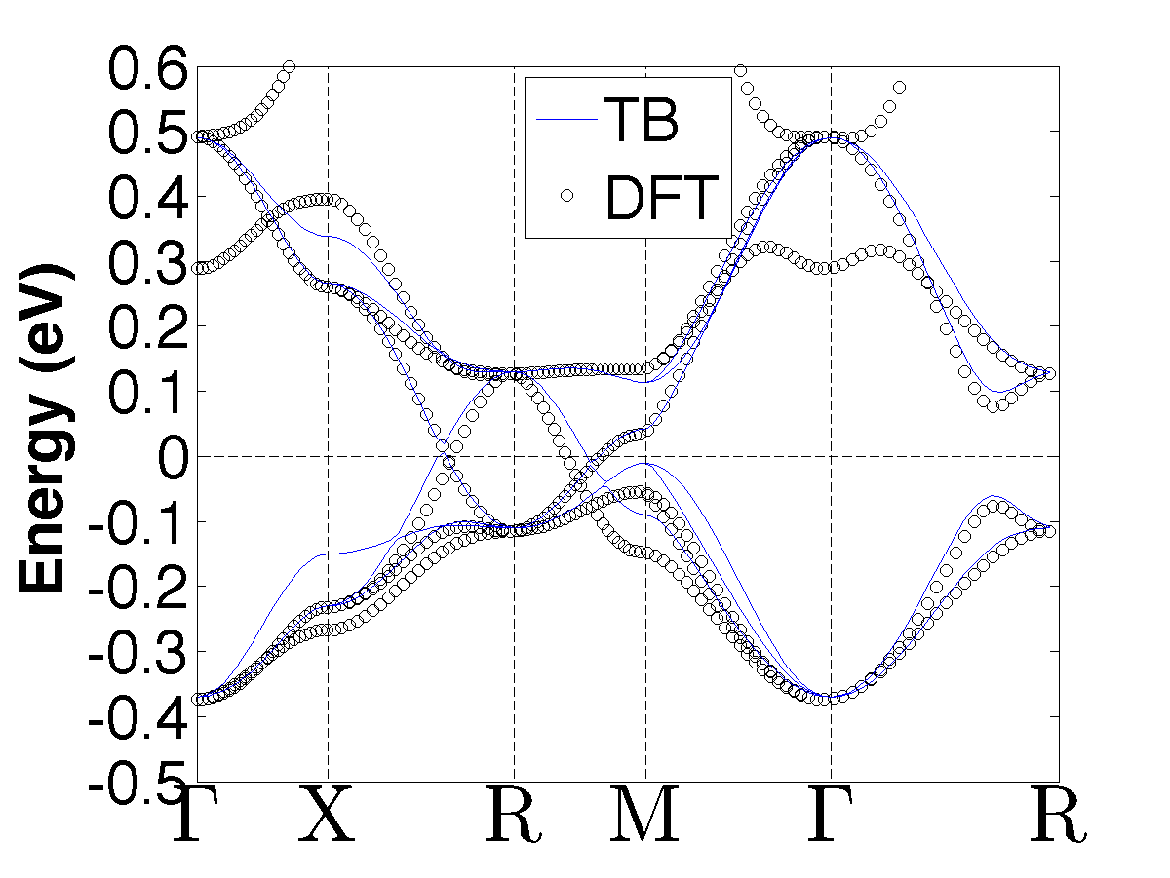
Mackay 6-1-1
0.0016
对6条带做了误差分析

Slide 3
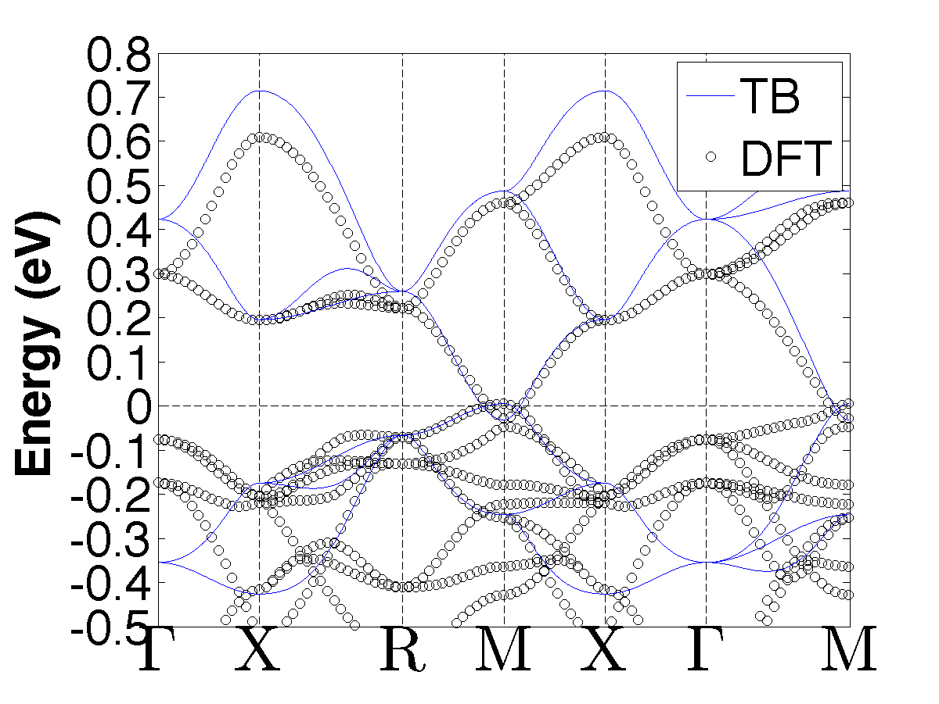
Mackay 6-1-2
New TB parameters:
Ed = 0.34163
Ep = -0.21024
Vpp6 = 0.0178911
Vppp = -0.045002
Vpdp = 0.0714
Vddp = 0.056847
Vddd = -0.072837
0.0061
只对3条导带做了误差分析

Slide 4
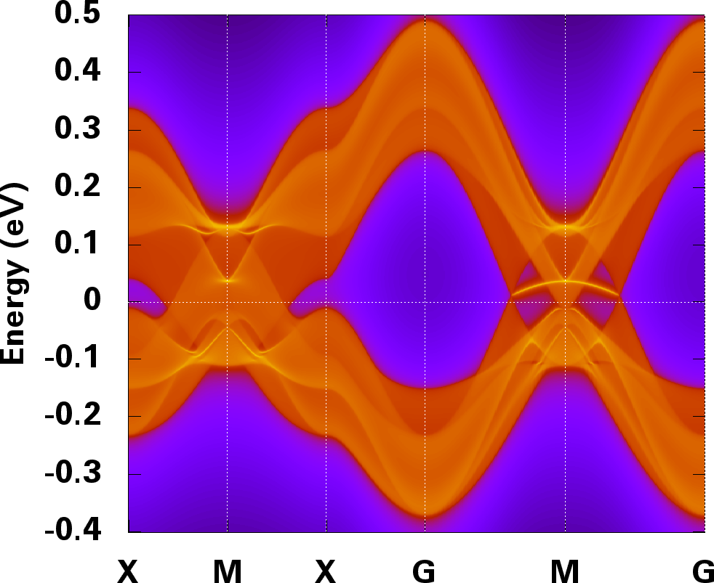
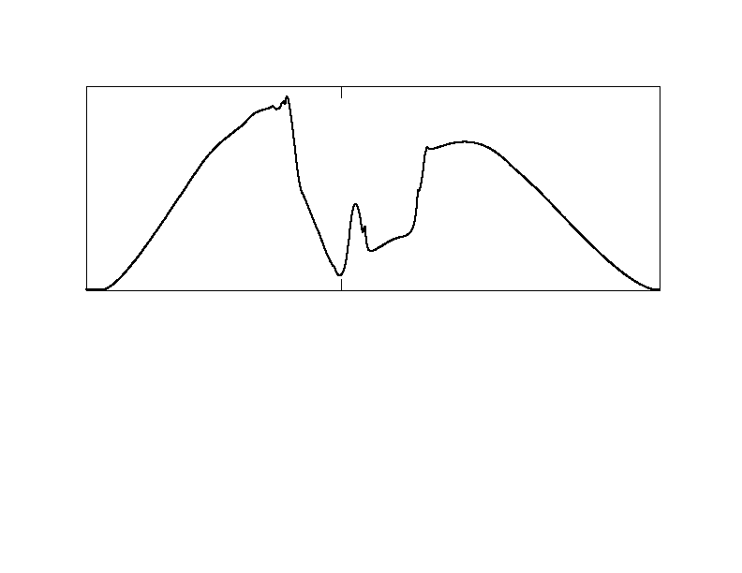
0 DOS 2

